Slide 1
How safe is air travel?

Slide 2
99.9%
Flights without incident

Slide 3
3K
Air
Fatalities
580K
Auto
Fatalities

Slide 4


Slide 5
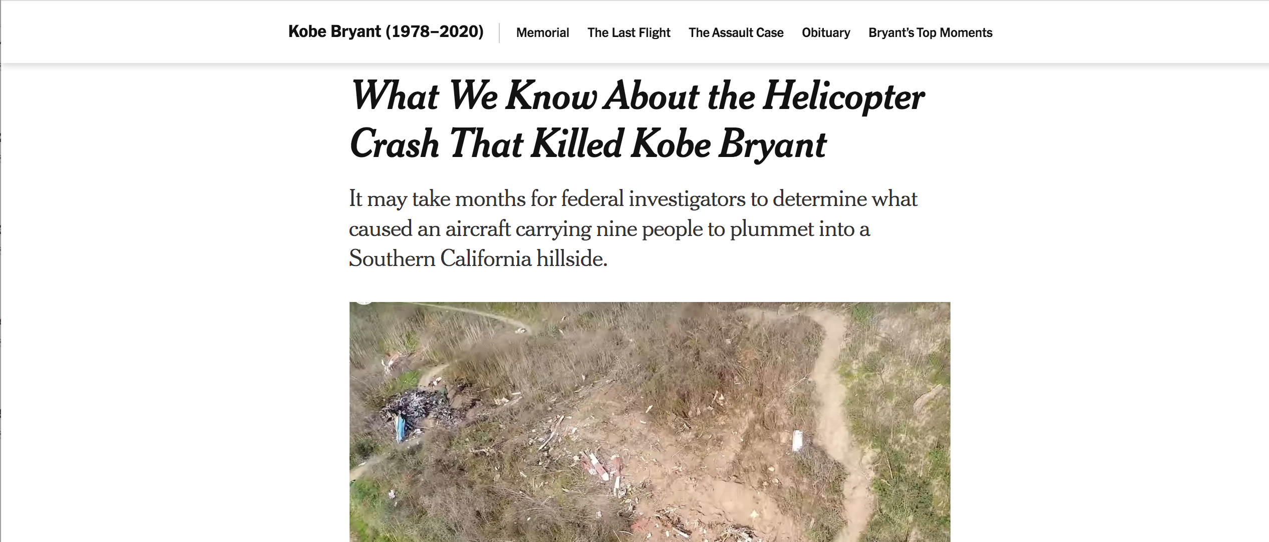

Slide 6
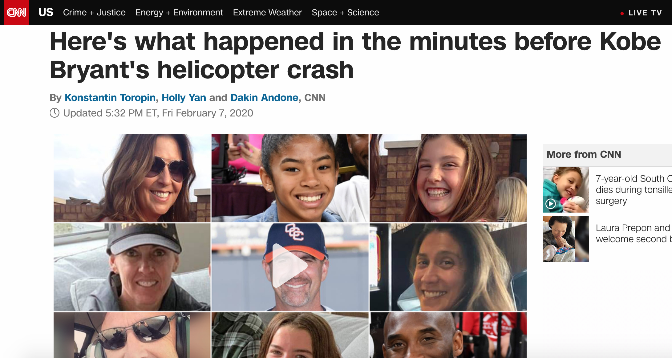

Slide 7
“Flying is far safer than driving.”
-USA Today

